Slide 1
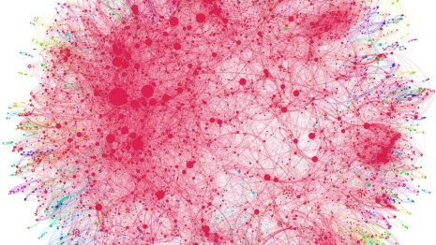
Improving Analytics GCP + GMP + Visualization = Effective Measurement
January 2022

Slide 2

AGENDA
Project Scope
Existing Landscape
Create the arch
Service account
Start coding

Slide 3
Project Goal We want to create a Better understanding of customer Behavior, purchase preferences and marketing effectiveness

Slide 4
What needs to be done?
Marketing Analytics | Scope
Map loyalty card data with purchases
Loyalty card data is currently housed on local servers, whereas for Purchase data we are required to use Google Analytics
Also map campaign information with the purchases and loyalty card details to understand effectiveness of marketing at customer level
Visualize the data in a BI platform, preferably Power BI
Automate the whole system with scheduled jobs

Slide 5
Understanding the background
Marketing Analytics | Landscape
Google Analytics 360 is implemented, that is Universal Analytics, and is having naïve integration with BigQuery
Only Loyalty card number can be sent on cloud platform, if required, but not customer PII can be hosted on cloud
Customer information can be provided in CSV files on local servers only

Slide 6

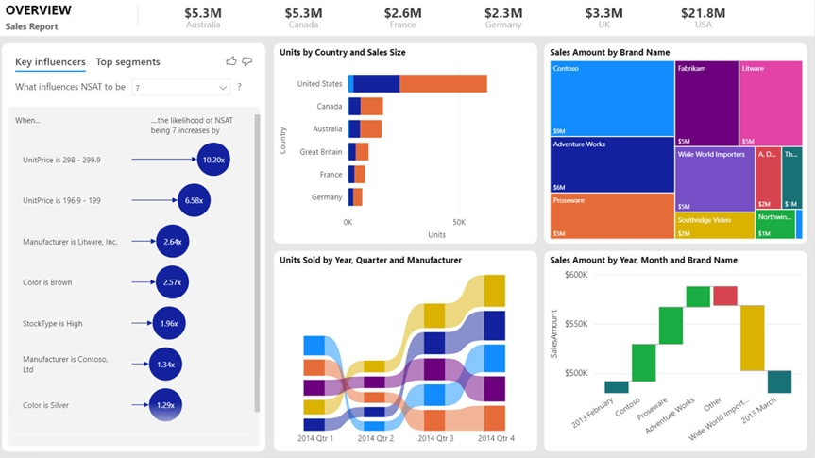

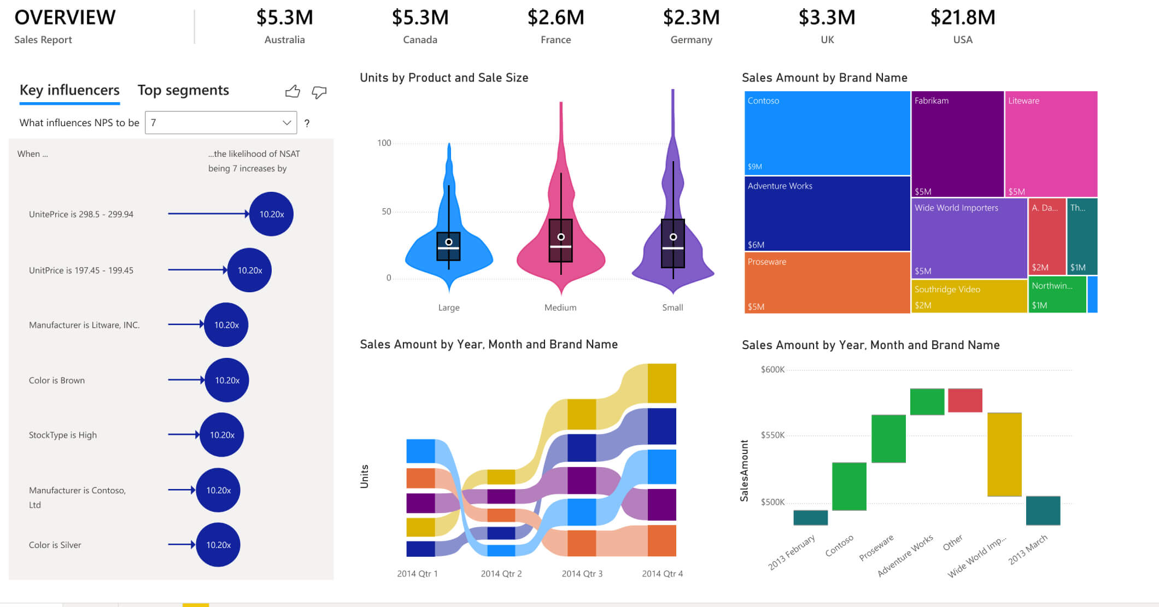



Creating the data flow
Marketing Analytics | Architecture
The architecture must bring together variety of tools and technologies
Python scripts will be used to upload customer loyalty card data within BigQuery
Google Analytics will have native integration with BigQuery
CSV files from local server will be uploaded within Power BI
Data Model and Visualizations will be created within Power BI
Automations will be built within Power BI and BigQuery

Slide 7
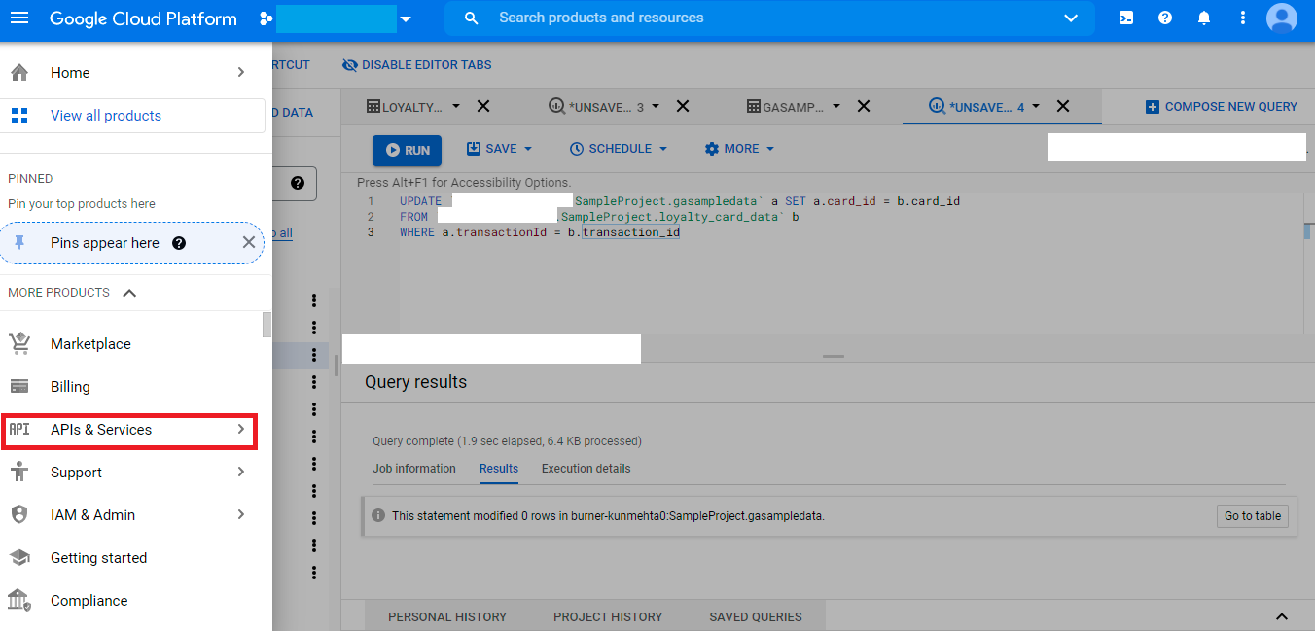
APIs and Services
Marketing Analytics | Service Account

Slide 8
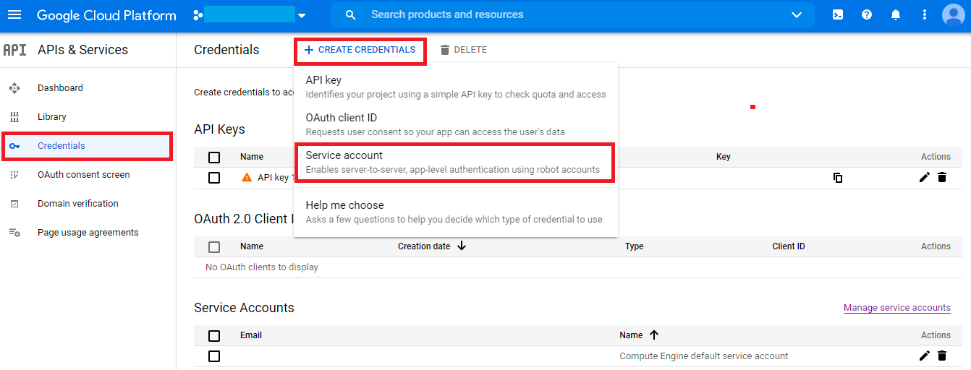
Create your Service Account
Marketing Analytics | Service Account

Slide 9
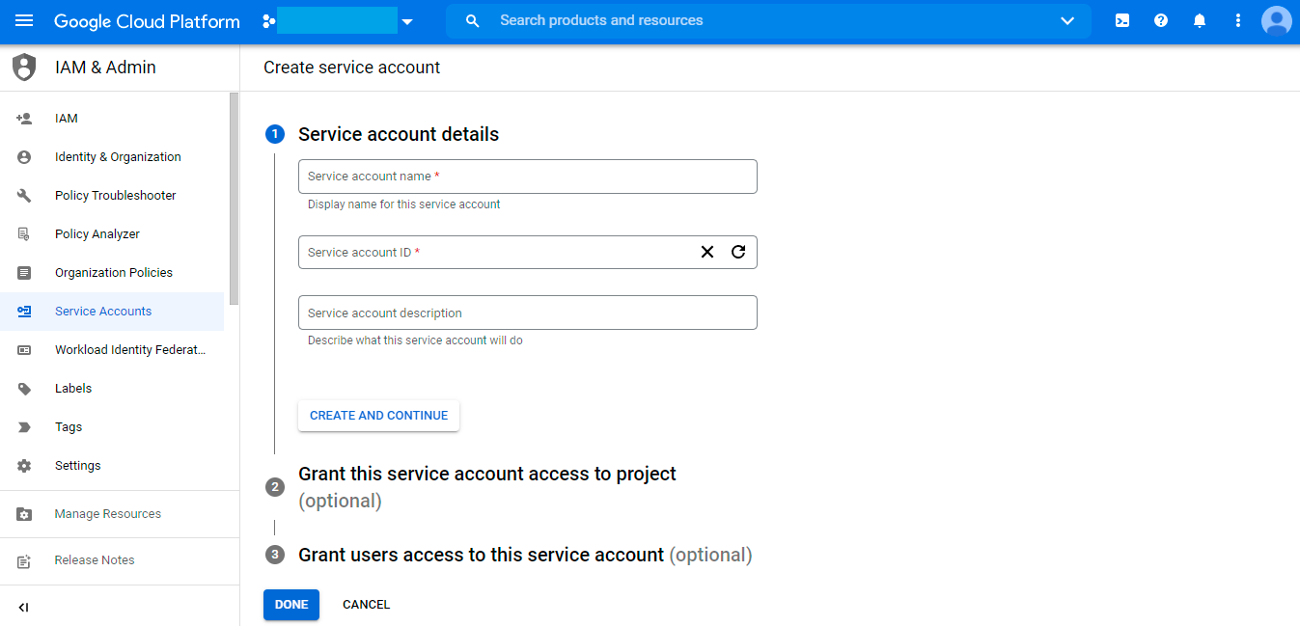
Download the JSON
Marketing Analytics | Service Account

Slide 10
Let’s Code

